Slide 1
CPSC 315 BI Technologies
Power BI Demo and Assignment

Slide 2
HW #2 Details
Due Wednesday, 2/5, by 5:00 pm
Submit your PowerPoint slides via GitHub Classroom
Assignment invitation: TBD
Share your finished Power BI work with me
Let’s keep this in the “cloud”
This presentation contains
Slides used during in-class demo
Specific instruction for the assignment

Slide 3
The story remains the same…
You are a real estate professional getting ready for a meeting with an important client. Your client is moving from across the country and wants to understand more about the homes for sale in a particular city. Your job is to produce Power BI Reports and a Dashboard that facilitate an investigation into the current state of the real estate market. Ultimately you will be telling a story that makes specific recommendations for your client.
Feel free to create a persona of your client
A young, price-conscious couple with three children, or
A single executive looking for an urban condo, or
An investor looking for bargain properties to fix-up and flip
Or, whatever you choose
Be sure to introduce your client in your presentation to provide context for your recommendations

Slide 4
Getting the Data
You can start with the final .xlsx from HW1
Or start over with a fresh redfin.com download
If you choose this option you will need to redo some of the pivot table work

Slide 5
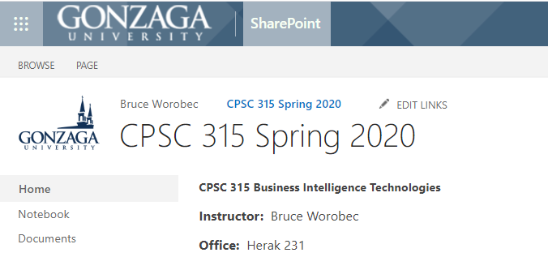
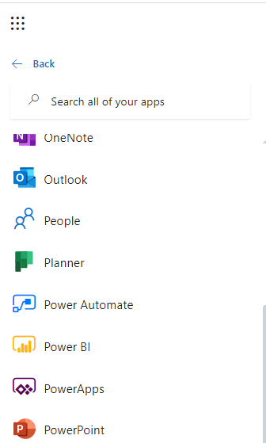
Launching Power BI in Office 365
Click the Waffle
Click “All apps →”
Scroll until you see “Power BI”

Slide 6
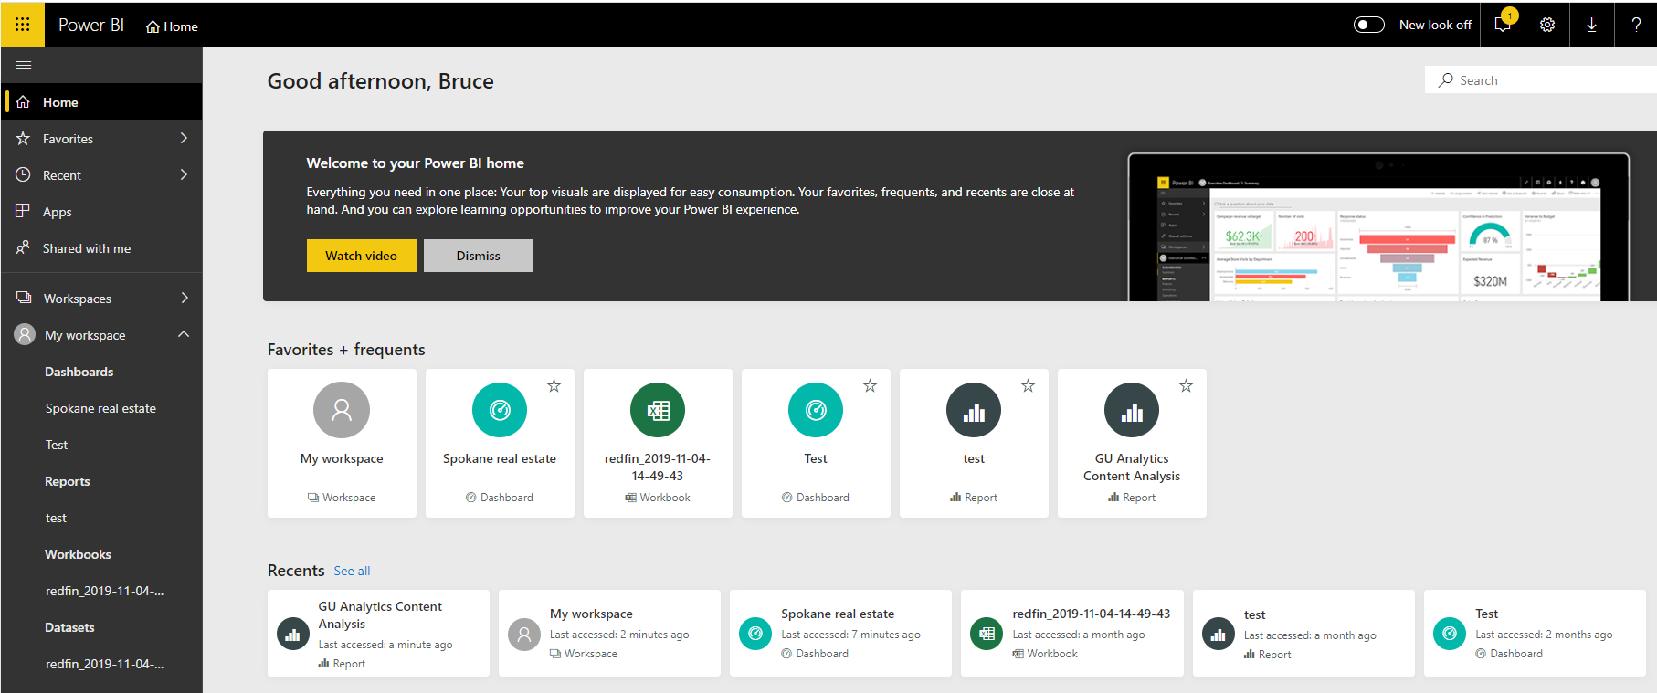
Power BI Home
Watch the video

Slide 7
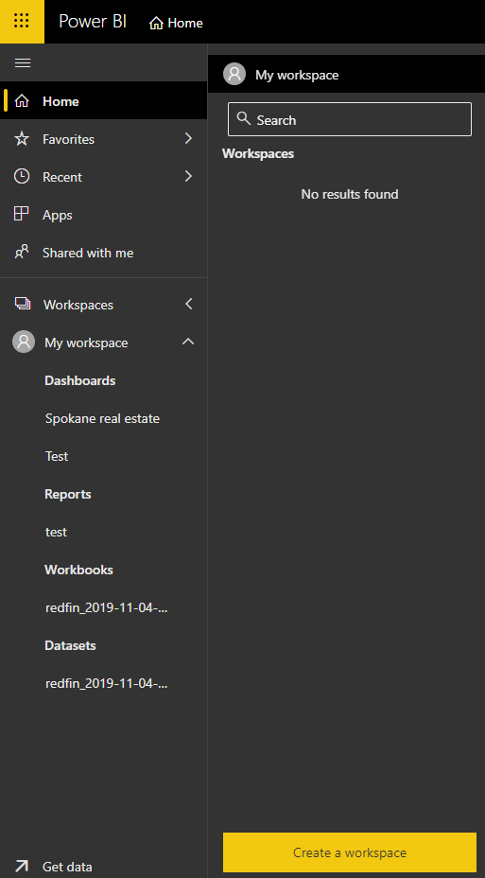
Create a Workspace for HW2
Click “Workspaces”
Click “Create Workspace”

Slide 8
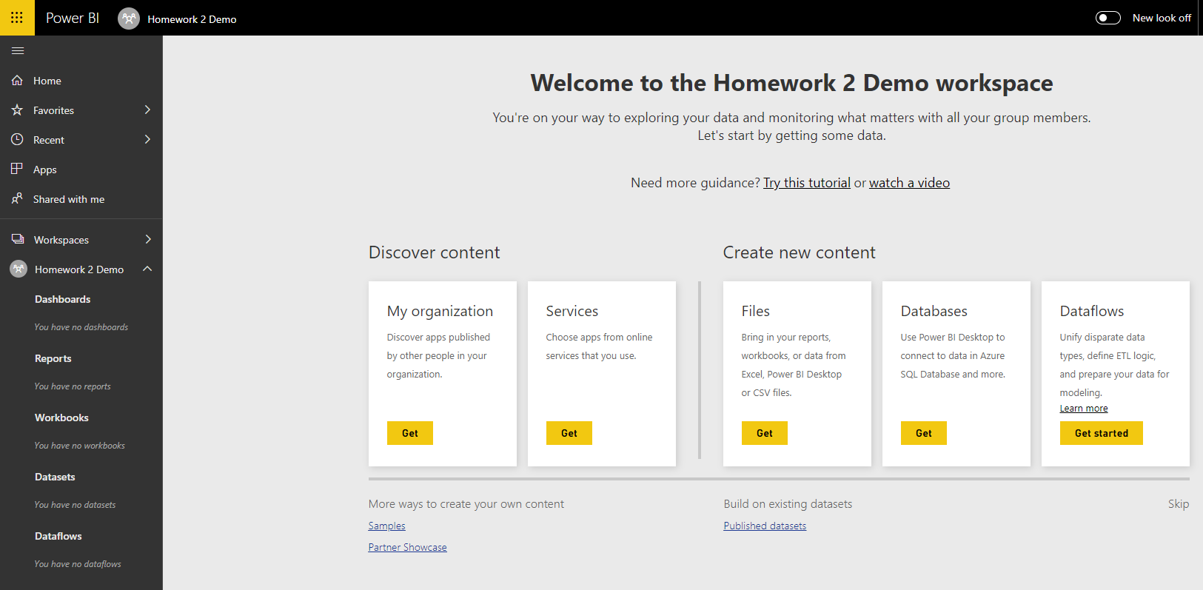
Get your HW1 Workbook
Click “Get” under Create New Content
Browse to your HW1 workbook

Slide 9
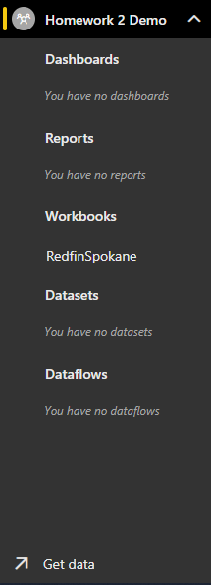
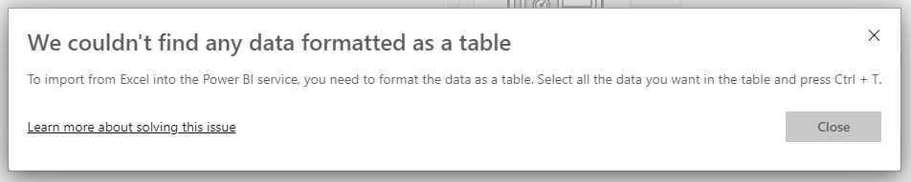
Get your HW1 Workbook
You get to choose between “Import” or “Upload”
Let’s do “Upload” first
You can see the results under “Workbooks”
Now click “Get Data” and try to do an “Import”
You may get this error—fix it

Slide 10
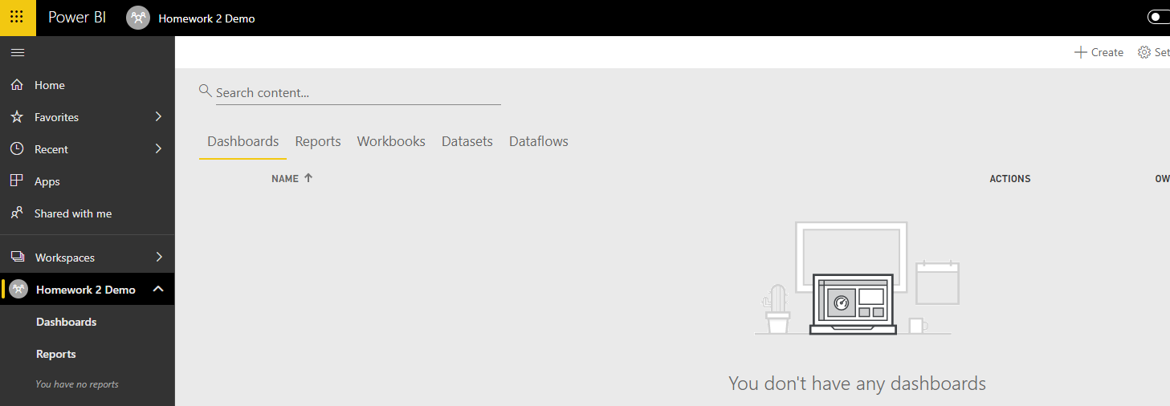
Create a Dashboard
I will create one called Pivot Charts
Then Pin all the charts from my HW1
First, Click on your Homework 2 workspace
Then Dashboards, then + Create

Slide 11
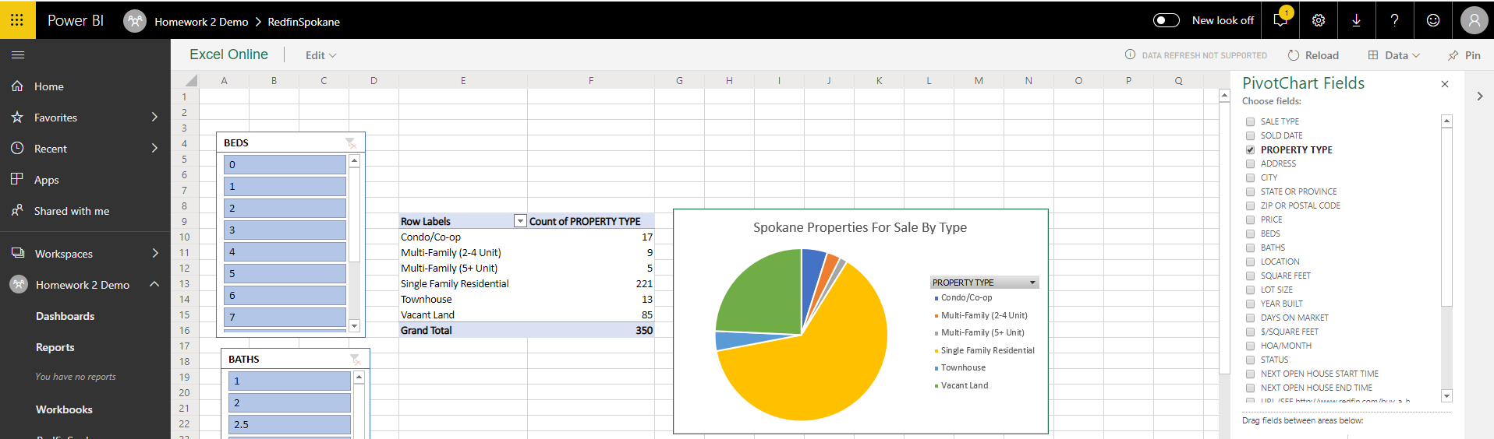
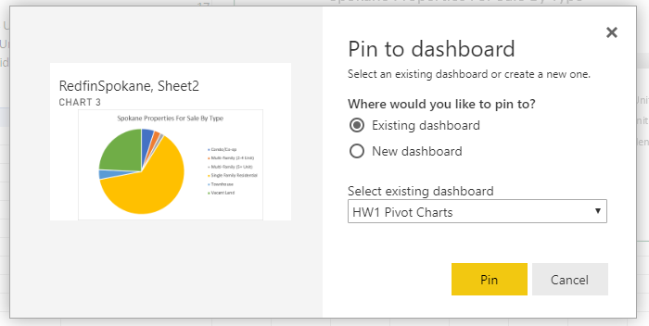
Create a Dashboard
Now Click on my HW1 workbook under Workbooks
Select each pivot chart and click Pin

Slide 12
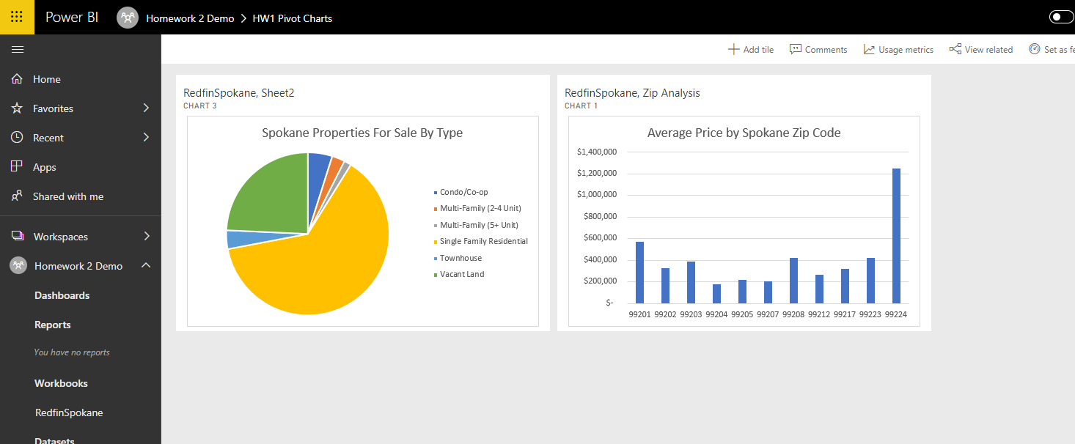
Create a Dashboard
Here is the resulting dashboard
All pivot charts gathered into one place
Easy to share and “in the cloud”

Slide 13
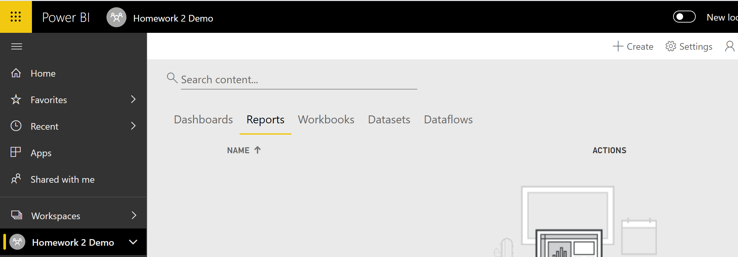
Create a Report
Navigate to your Workspace
Click “+ Create”
Click “Report”
Select your dataset

Slide 14
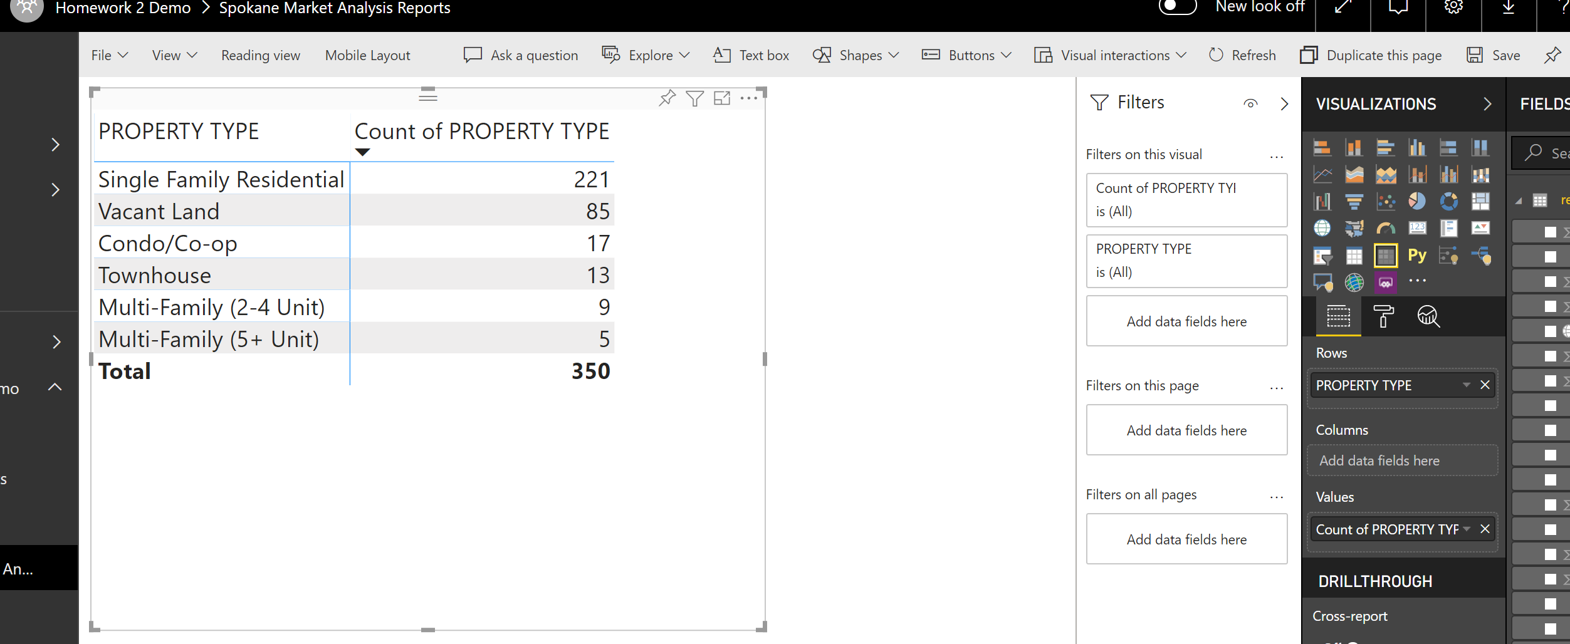
Create a Report
Rename the sheet to “Property Type Analysis”
Find the “Matrix” visualization
Use “Property Type” as Rows
Use “Count of Property Type” as Values

Slide 15
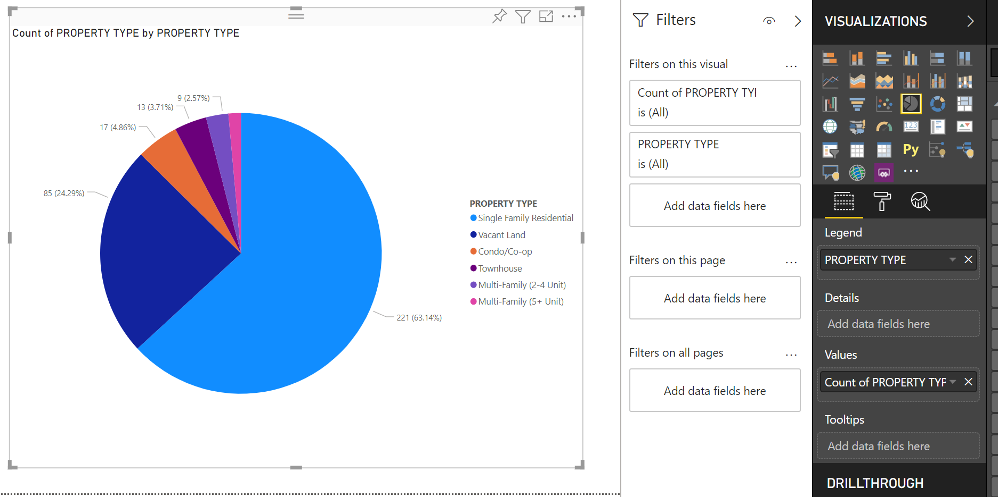
Create a Report
Find the “Pie Chart” visualization

Slide 16
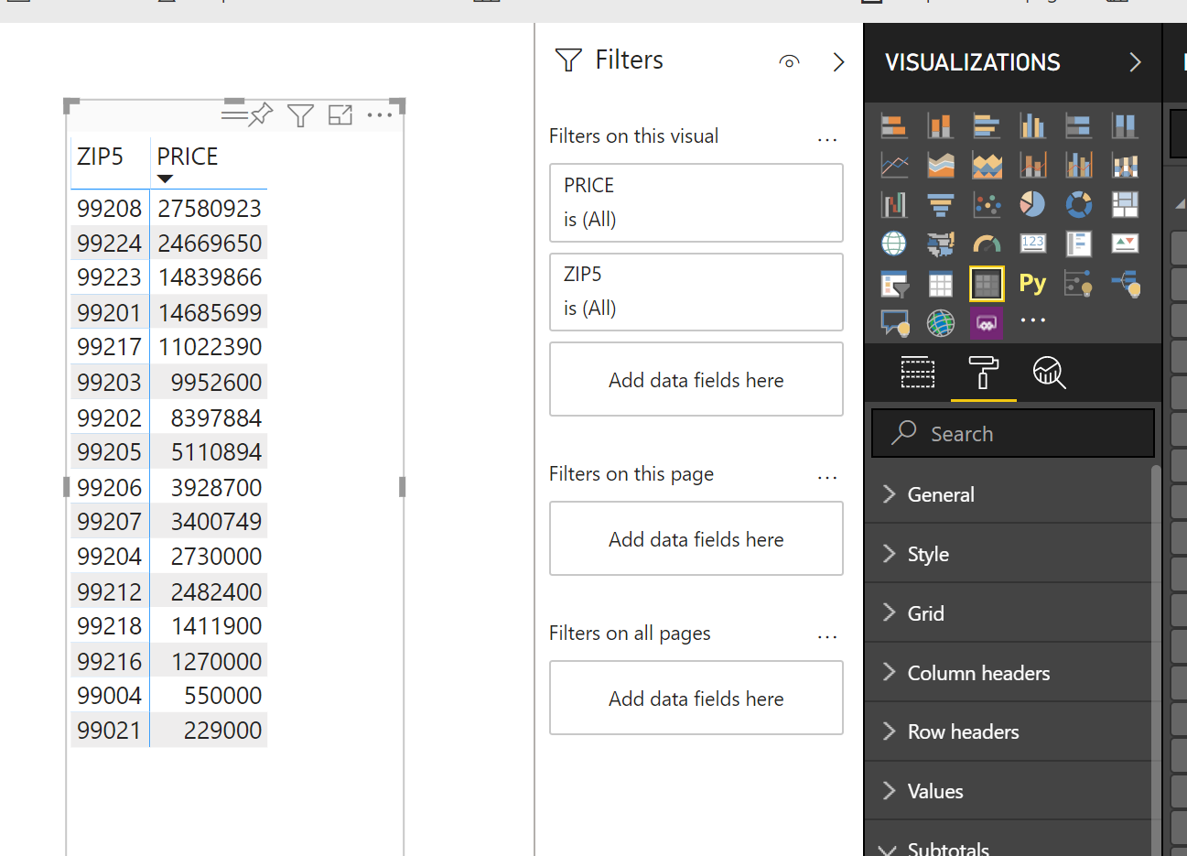
Add a Second Sheet (Zip Code Analysis)
Add a Sheet
Rename the sheet to “Zip Code Analysis”
Find the “Matrix” visualization
Use “Zip5” as Rows
Use “Average of Price” as Values
Turn Row Subtotals off

Slide 17
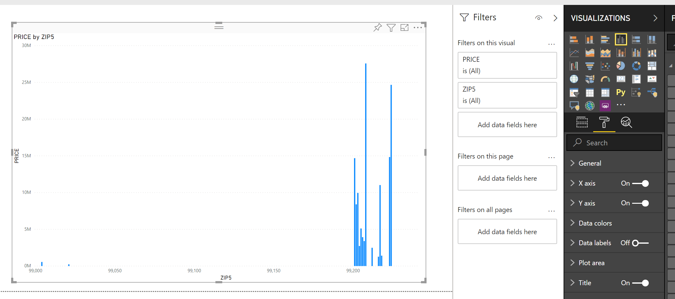
Add a Second Sheet (Zip Code Analysis)
Find the “Clustered Column Chart” visualization
What is going on?

Slide 18
The fix
My Zip5 field was being treated as an integer
Many Google searches followed
All results showed how to fix this in Power BI Desktop
After an hour or so…
Homework 2 just became a mix of cloud and desktop

Slide 19
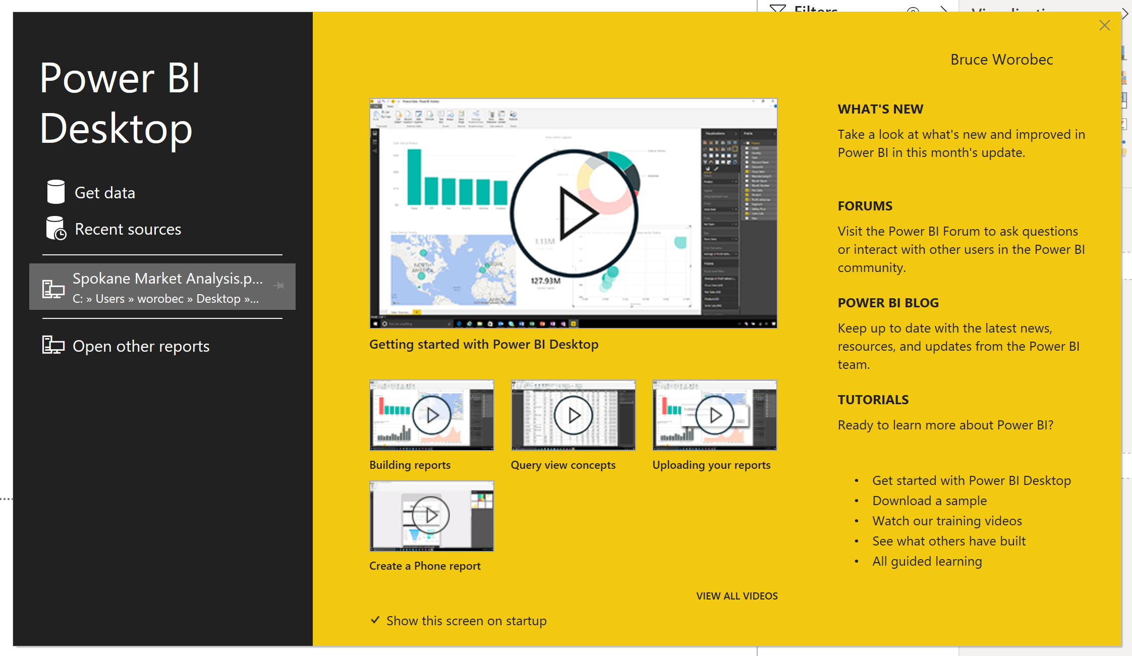
Power BI Desktop
Download here: https://powerbi.microsoft.com/en-us/downloads/
Launch and watch the videos

Slide 20
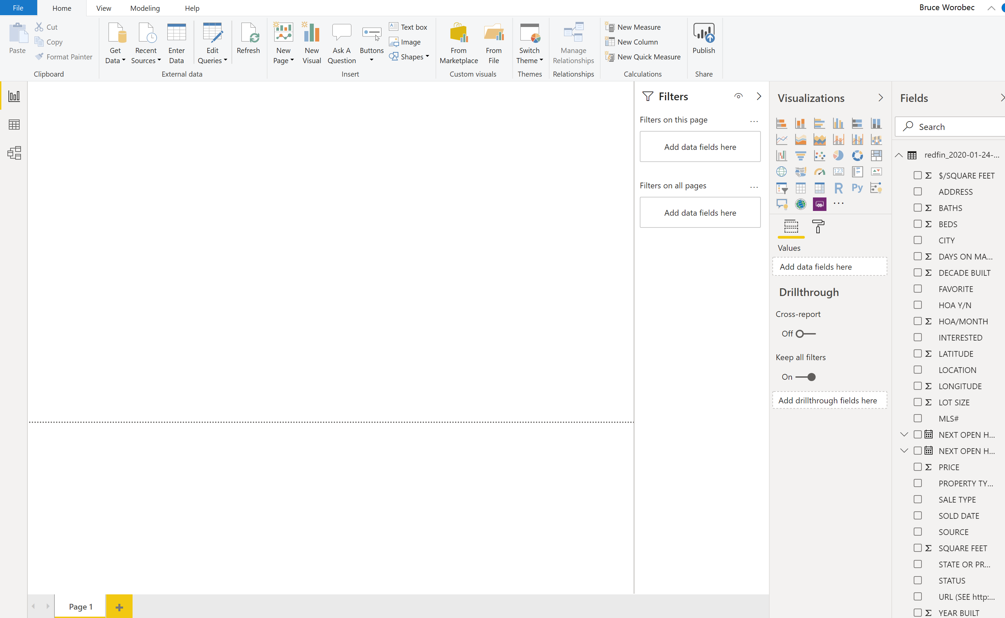
Build a Power BI Desktop Report
File, Get Data, Excel, browse to your HW1 .xlsx
Select the sheet that has the raw data and click Load

Slide 21
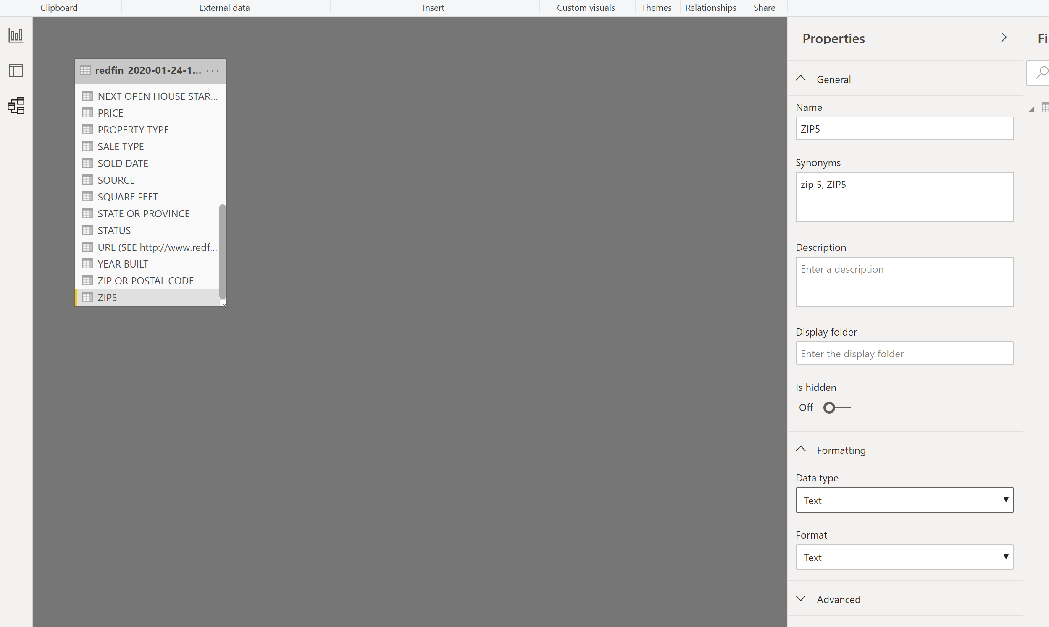
Build a Power BI Desktop Report
Rename the sheet “Zip Code Analysis”
Click the “Model” icon
Select “Zip5”
Change Data Type to “Text”
Also change the format of “Price” to Currency

Slide 22
A note on the Modeling View…
This gives you a place to set up complex datasets
Including joins between multiple tables/data sources
Dive deeper on your own to build a resume skill or if you plan to eventually do this for $$$$
https://docs.microsoft.com/en-us/power-bi/desktop-modeling-view
https://www.youtube.com/watch?v=VlcHMRiKLT8

Slide 23
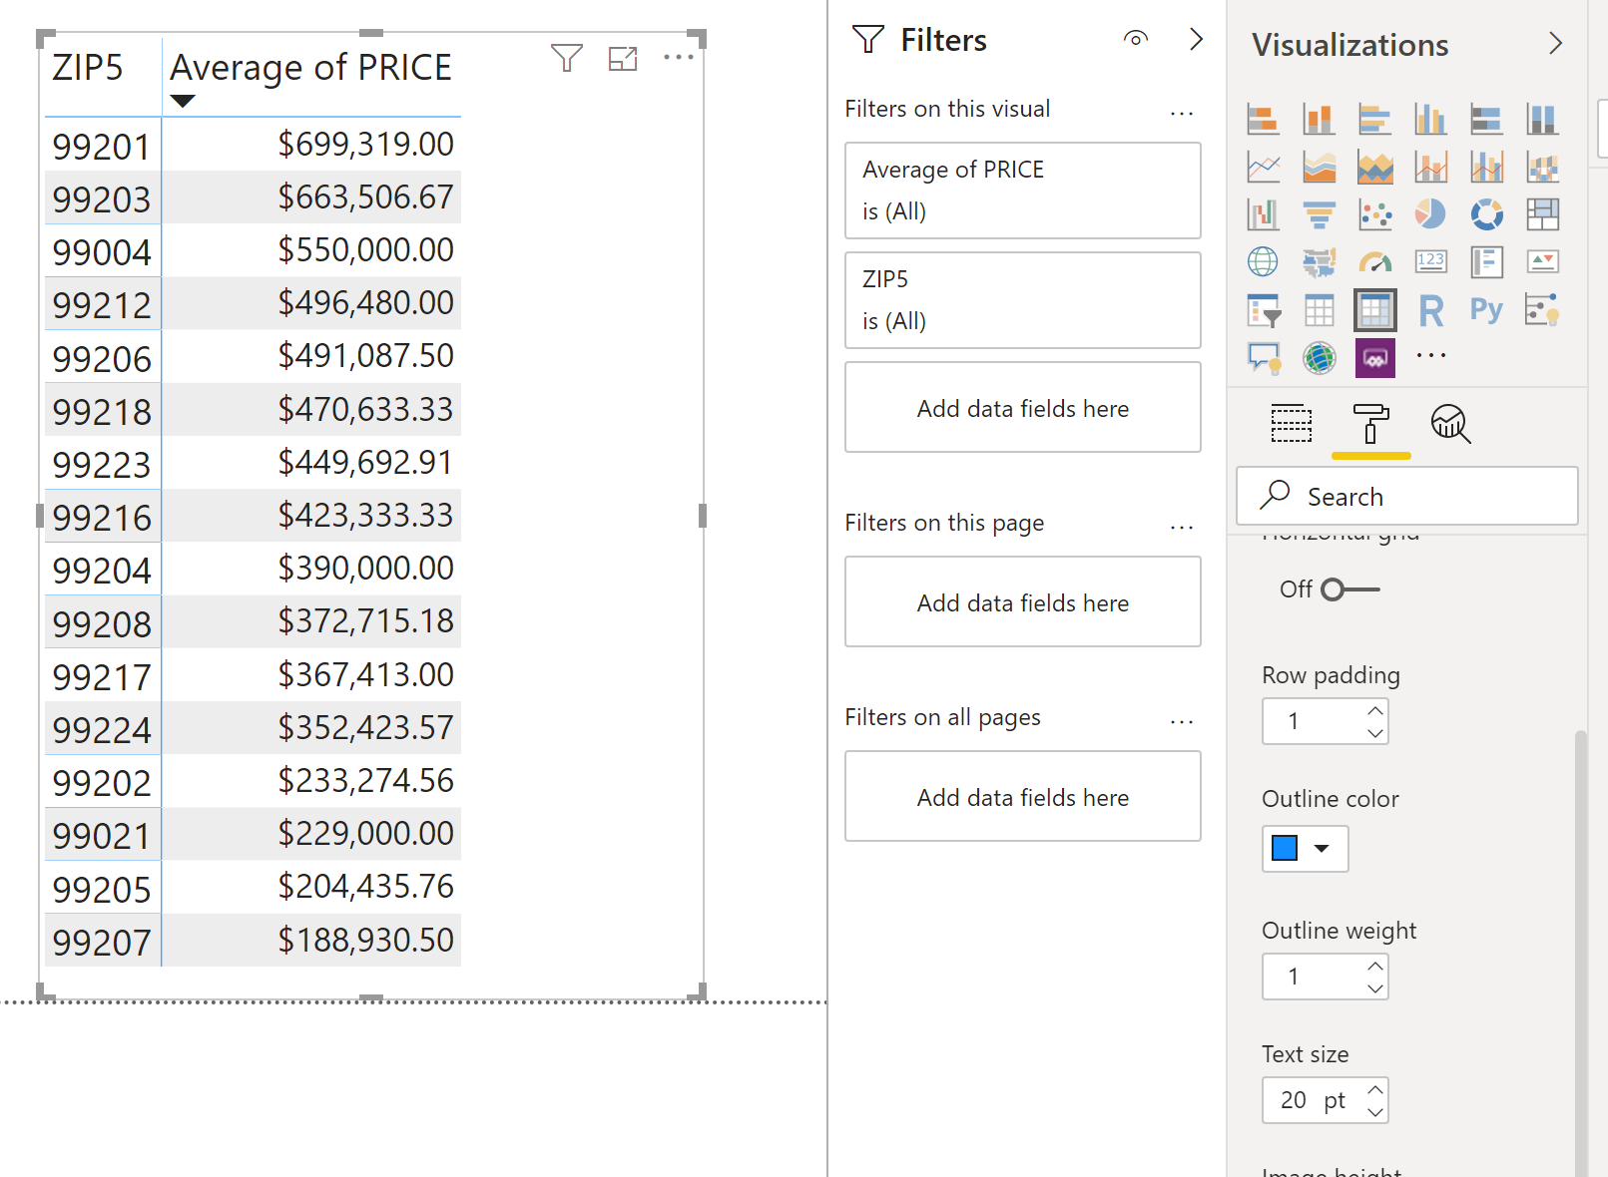
Build a Power BI Desktop Report
Return to “Report View”
Click on “Matrix”
Use “Zip5” as Rows
Use “Average of Price” as Values
Turn Row Subtotals off
Use “Format Painter” to change font size of the Grid

Slide 24
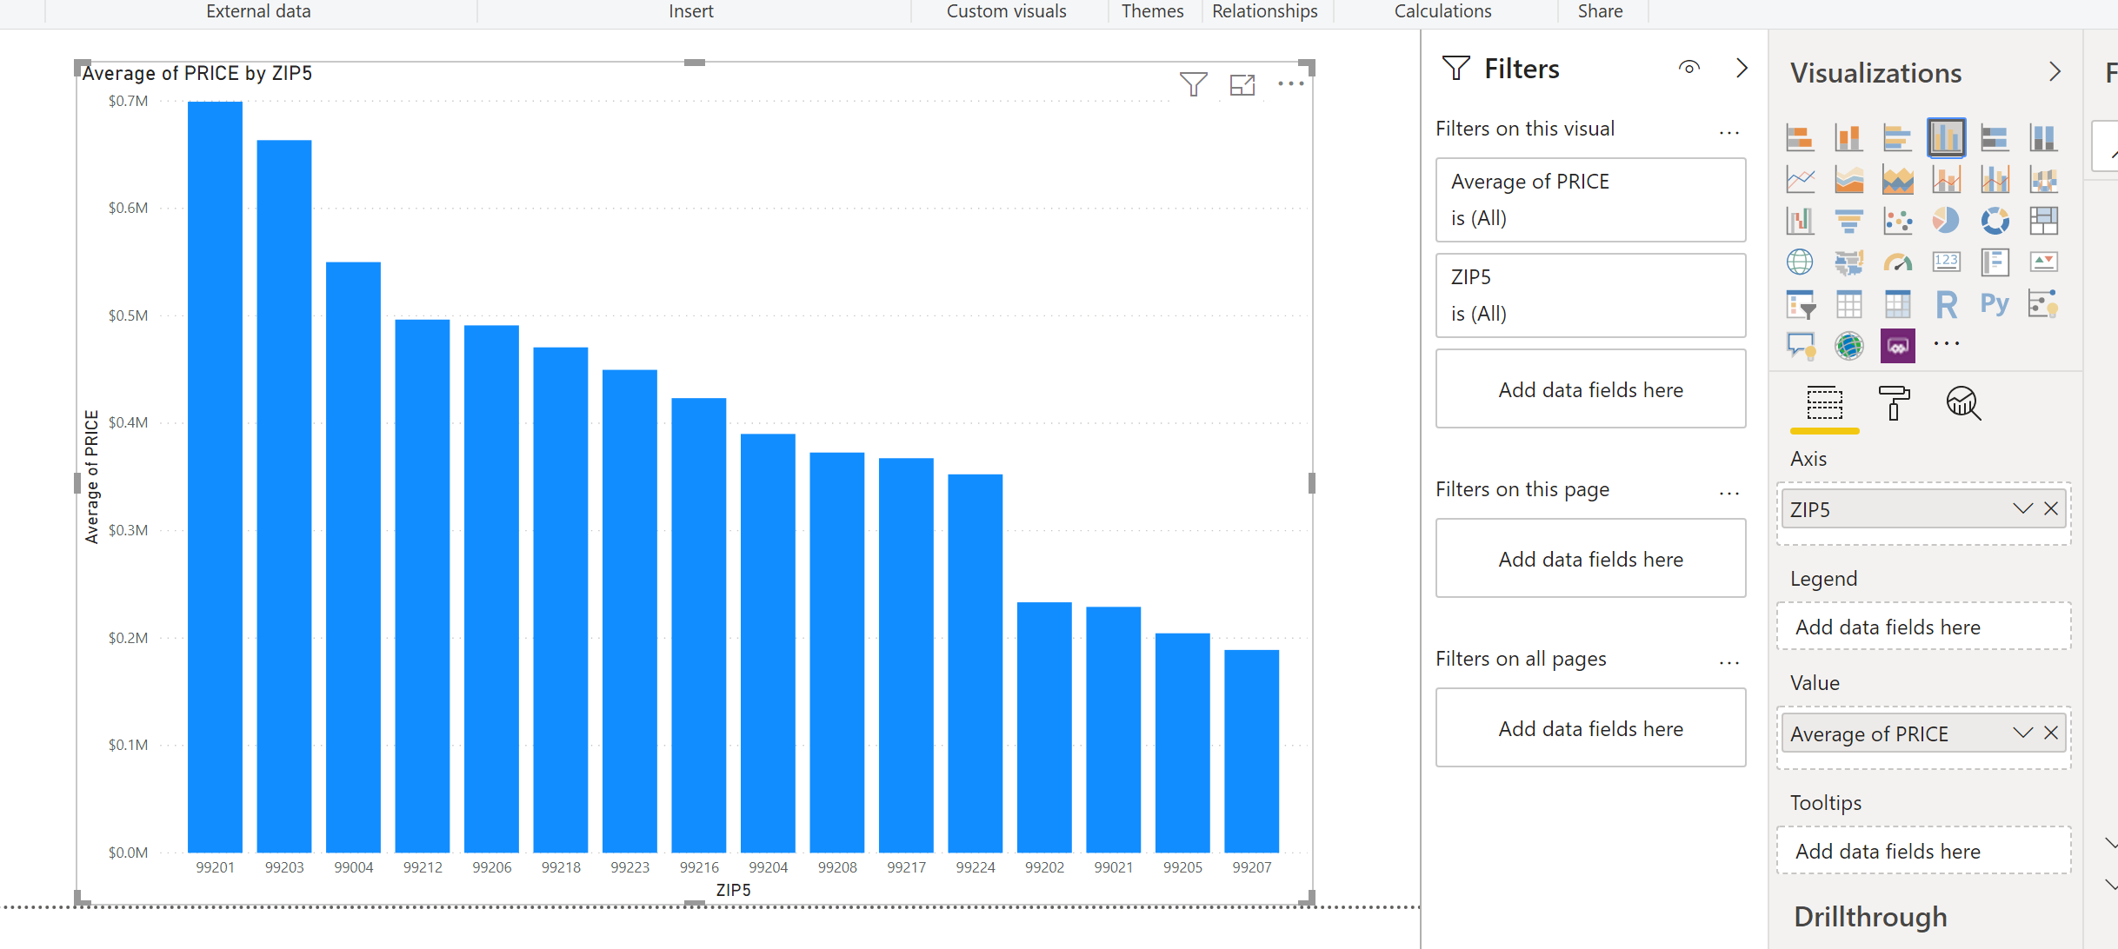
Build a Power BI Desktop Report
Click on Clustered Column Chart”

Slide 25
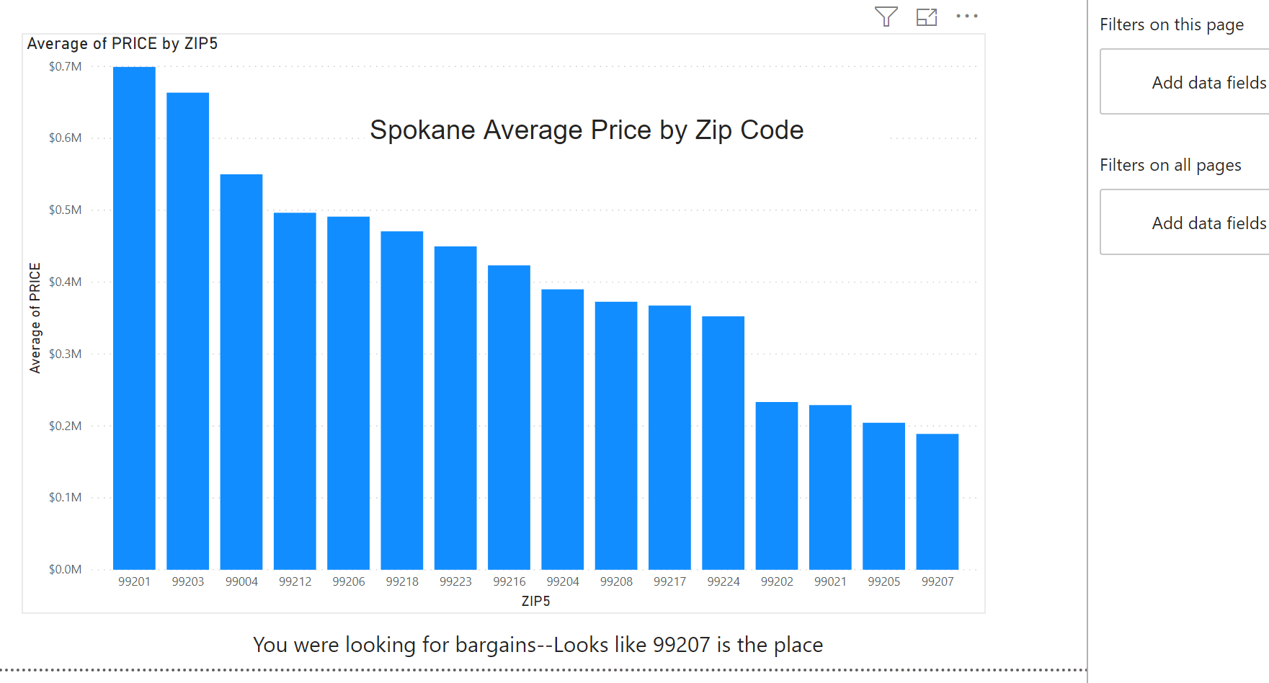
Build a Power BI Desktop Report
Add a text box for a title
Add another text box to embed your story as a caption

Slide 26
Save and move to the cloud
I will save as “Zip Analysis from Desktop”
Publish to my cloud
File, Publish, Power BI
Select my Homework 2 Workspace
Use GU credentials if not already logged in to Office 365

Slide 27
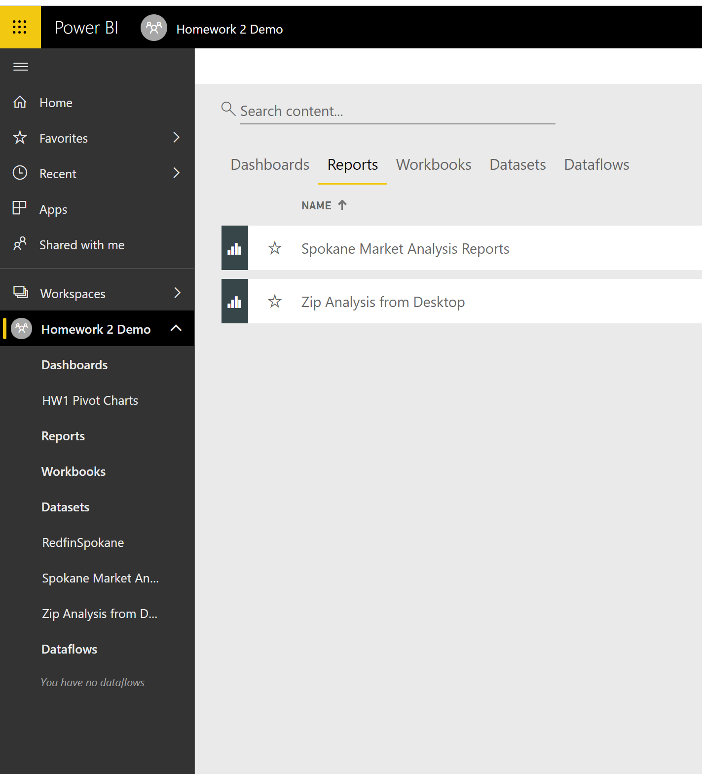
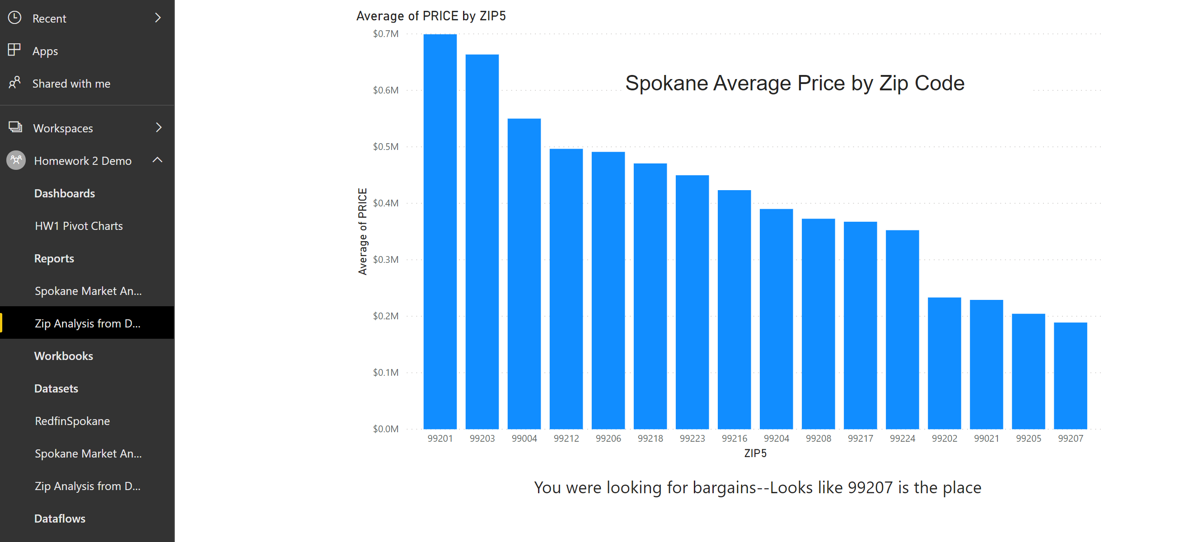
My workspace now

Slide 28
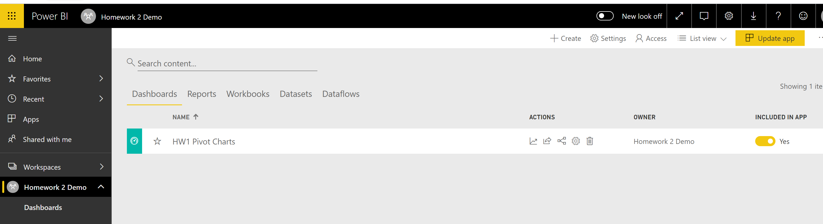
Publish an App
As Faculty I get a “Pro” license
Not available with your student license
Let’s check this—LMK what happens when you try to publish an app
Link to my published app
https://app.powerbi.com/Redirect?action=OpenApp&appId=56e018a9-4b70-41a2-a3f5-b209804fd54b&ctid=2ba33407-5ccc-4940-bd16-ae154f04c3ca

Slide 29
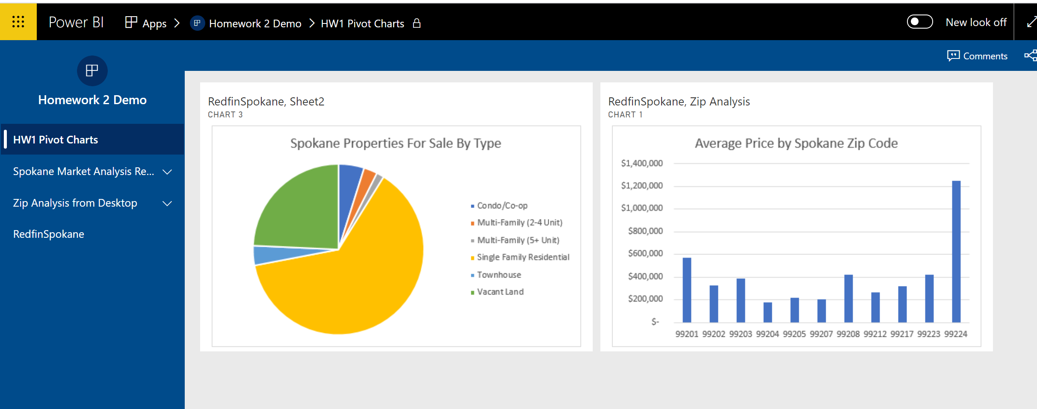
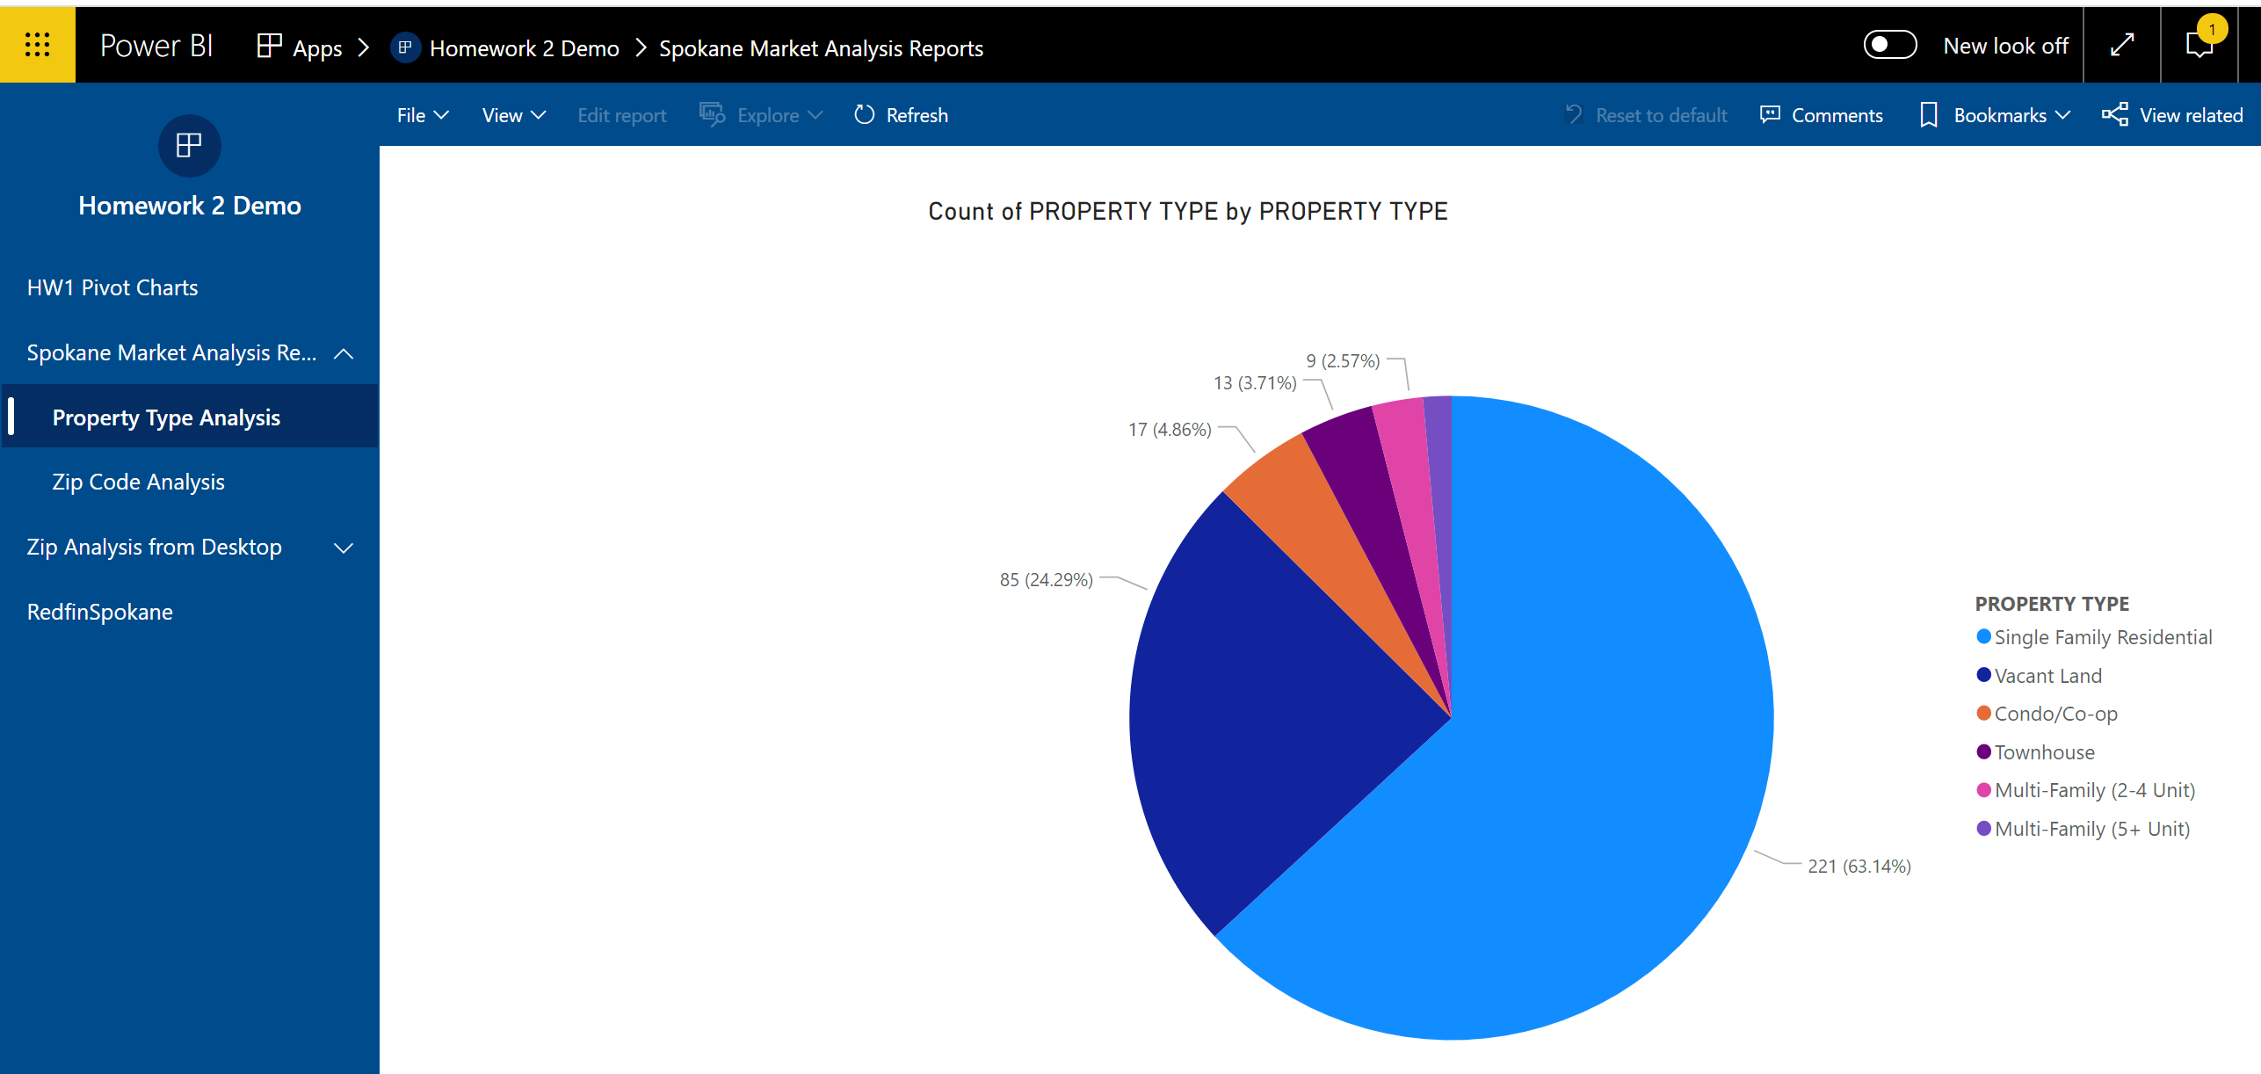
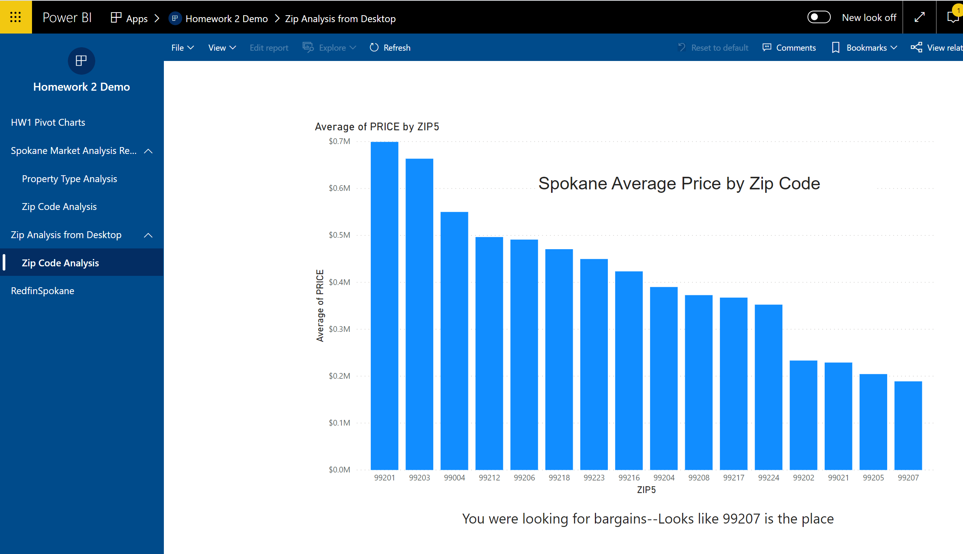
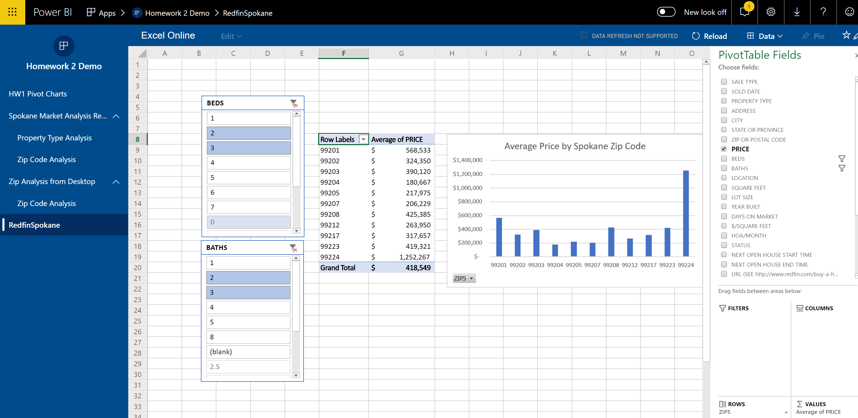
My published app

Slide 30
My published app
Note that my app included
A dashboard with visualizations pinned from pivot charts
A report authored in Office 365 Power BI
A report authored in Power BI Desktop and published to Office 365
An Excel workbook with pivot tables and charts made available via Excel Online
In the homework instructions that follow you will need to do all of these things plus anything else you learn that builds on this foundation

Slide 31
Homework 2 High Level Instructions
Repeat Homework #1 but with all data and visualization included in the presentation coming from Power BI
You are free to pick different a different city or refresh the listings from your original city
You are free to pick a different client
You are free to enhance your Homework 1 story as your technical skills and storytelling improve

Slide 32
Homework 2 Detailed Requirements
Create a single Power BI workspace for Homework 2 that includes the following
A dashboard with multiple tiles pinned from pivot charts
You may add additional tiles from your Power BI report work or other sources as appropriate
A report with at least two sheets authored in Office 365 Power BI
A report with at least two sheets authored in Power BI Desktop and published to your Homework 2 workspace
Your Homework 1 workbook (or updated equivalent) uploaded into your workspace and available via Excel Online
Note: The four sheets produced in Power BI reports should be at least as complex as the four pivot tables/charts requested in Homework 1

Slide 33
Homework 2 Additional Considerations
In Homework 1 you snipped data and visualizations to include in your presentation
These snips were then interspersed with PowerPoint text to tell your story
Power BI Reports allow multiple tiles for data, visualizations, titles, and captions per sheet
Some argue that a Power BI Report should not require a separate slide deck and that the story should be told simply by navigating through the sheets
For Homework 2 I still want a separate slide deck with snips from Power BI, but…
Strive for report sheets and a dashboard that can be snipped in their entirety and will not need to be supplemented to form a presentation slide

Slide 34
For your assignment submission
Produce a 10 slide PowerPoint deck and upload to GitHub Classroom
Use a few slides to show that you completed everything requested
Using the Reports and Dashboard you built, dive into the data and look for buying opportunities for your client
Perhaps identify zip codes that provide better value, or
Property types that have been on the market for a while that could be ready for a price reduction, or
Include DECADE BUILT in your analysis
Maybe there are opportunities for newer homes, or older homes, or ???
Something else you discover in the data
Use the remaining slides to make recommendation to your client based on the above analysis
Be sure to include snips from Power BI that support your recommendation
Remember to share your Workspace with me for grading
Bruce Worobec - worobec@gonzaga.edu

Slide 35
Final thoughts
You have creative license, use it
You do not need my permission to go above and beyond what was requested
Be sure you tell a story
Support your decisions and recommendations with data and visualization
Numerous how-to videos are available online
Do a search for “Power BI video” if you get stuck
Power BI is an excellent resume and interview item
Use this assignment to build a skill for a lifetime

